Slide 1

PROJECT 3
JUSTIN NOLAN
RUBY BHATIA
NATHAN ROLLER
DARELL JOHNSON

Slide 2
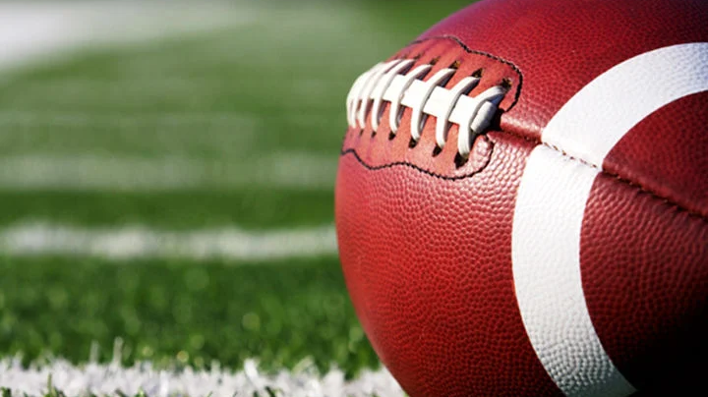
PROJECT FOCUS
This project will focus on analyzing and visualizing data from all NFL Week 1 games. By leveraging data visualization tools, we aim to extract key insights from game logs, such as team performance, scoring trends, and team comparisons. Our project will provide an interactive platform that allows users to explore different aspects of the data through filters, charts, and tables.

Slide 3

DATA SOURCE
NFL vs.data – play_by_play_2024_cleaned.csv
https://github.com/nflverse/nflverse-data/releases/tag/pbp

Slide 4

DATA CLEANUP AND EXPLORATION

Slide 5

HOW DO TEAMS PERFORM OFFENSIVELY IN NFL WEEK 1 GAMES?

Slide 6
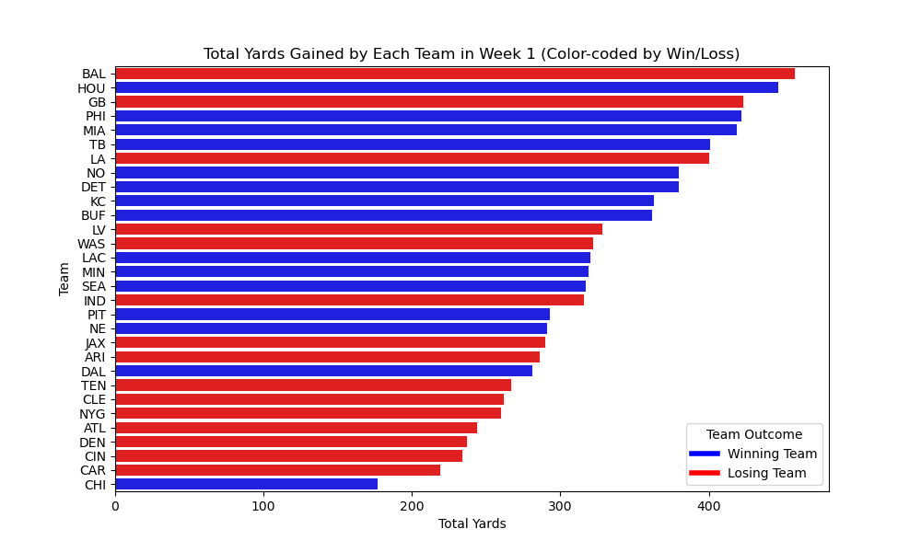
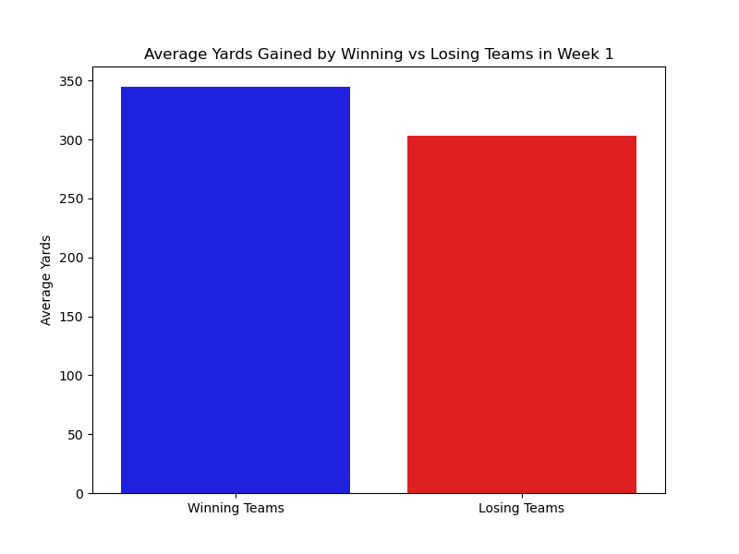

Slide 7
What are tendencies for teams in specific down and distance situations?

Slide 8
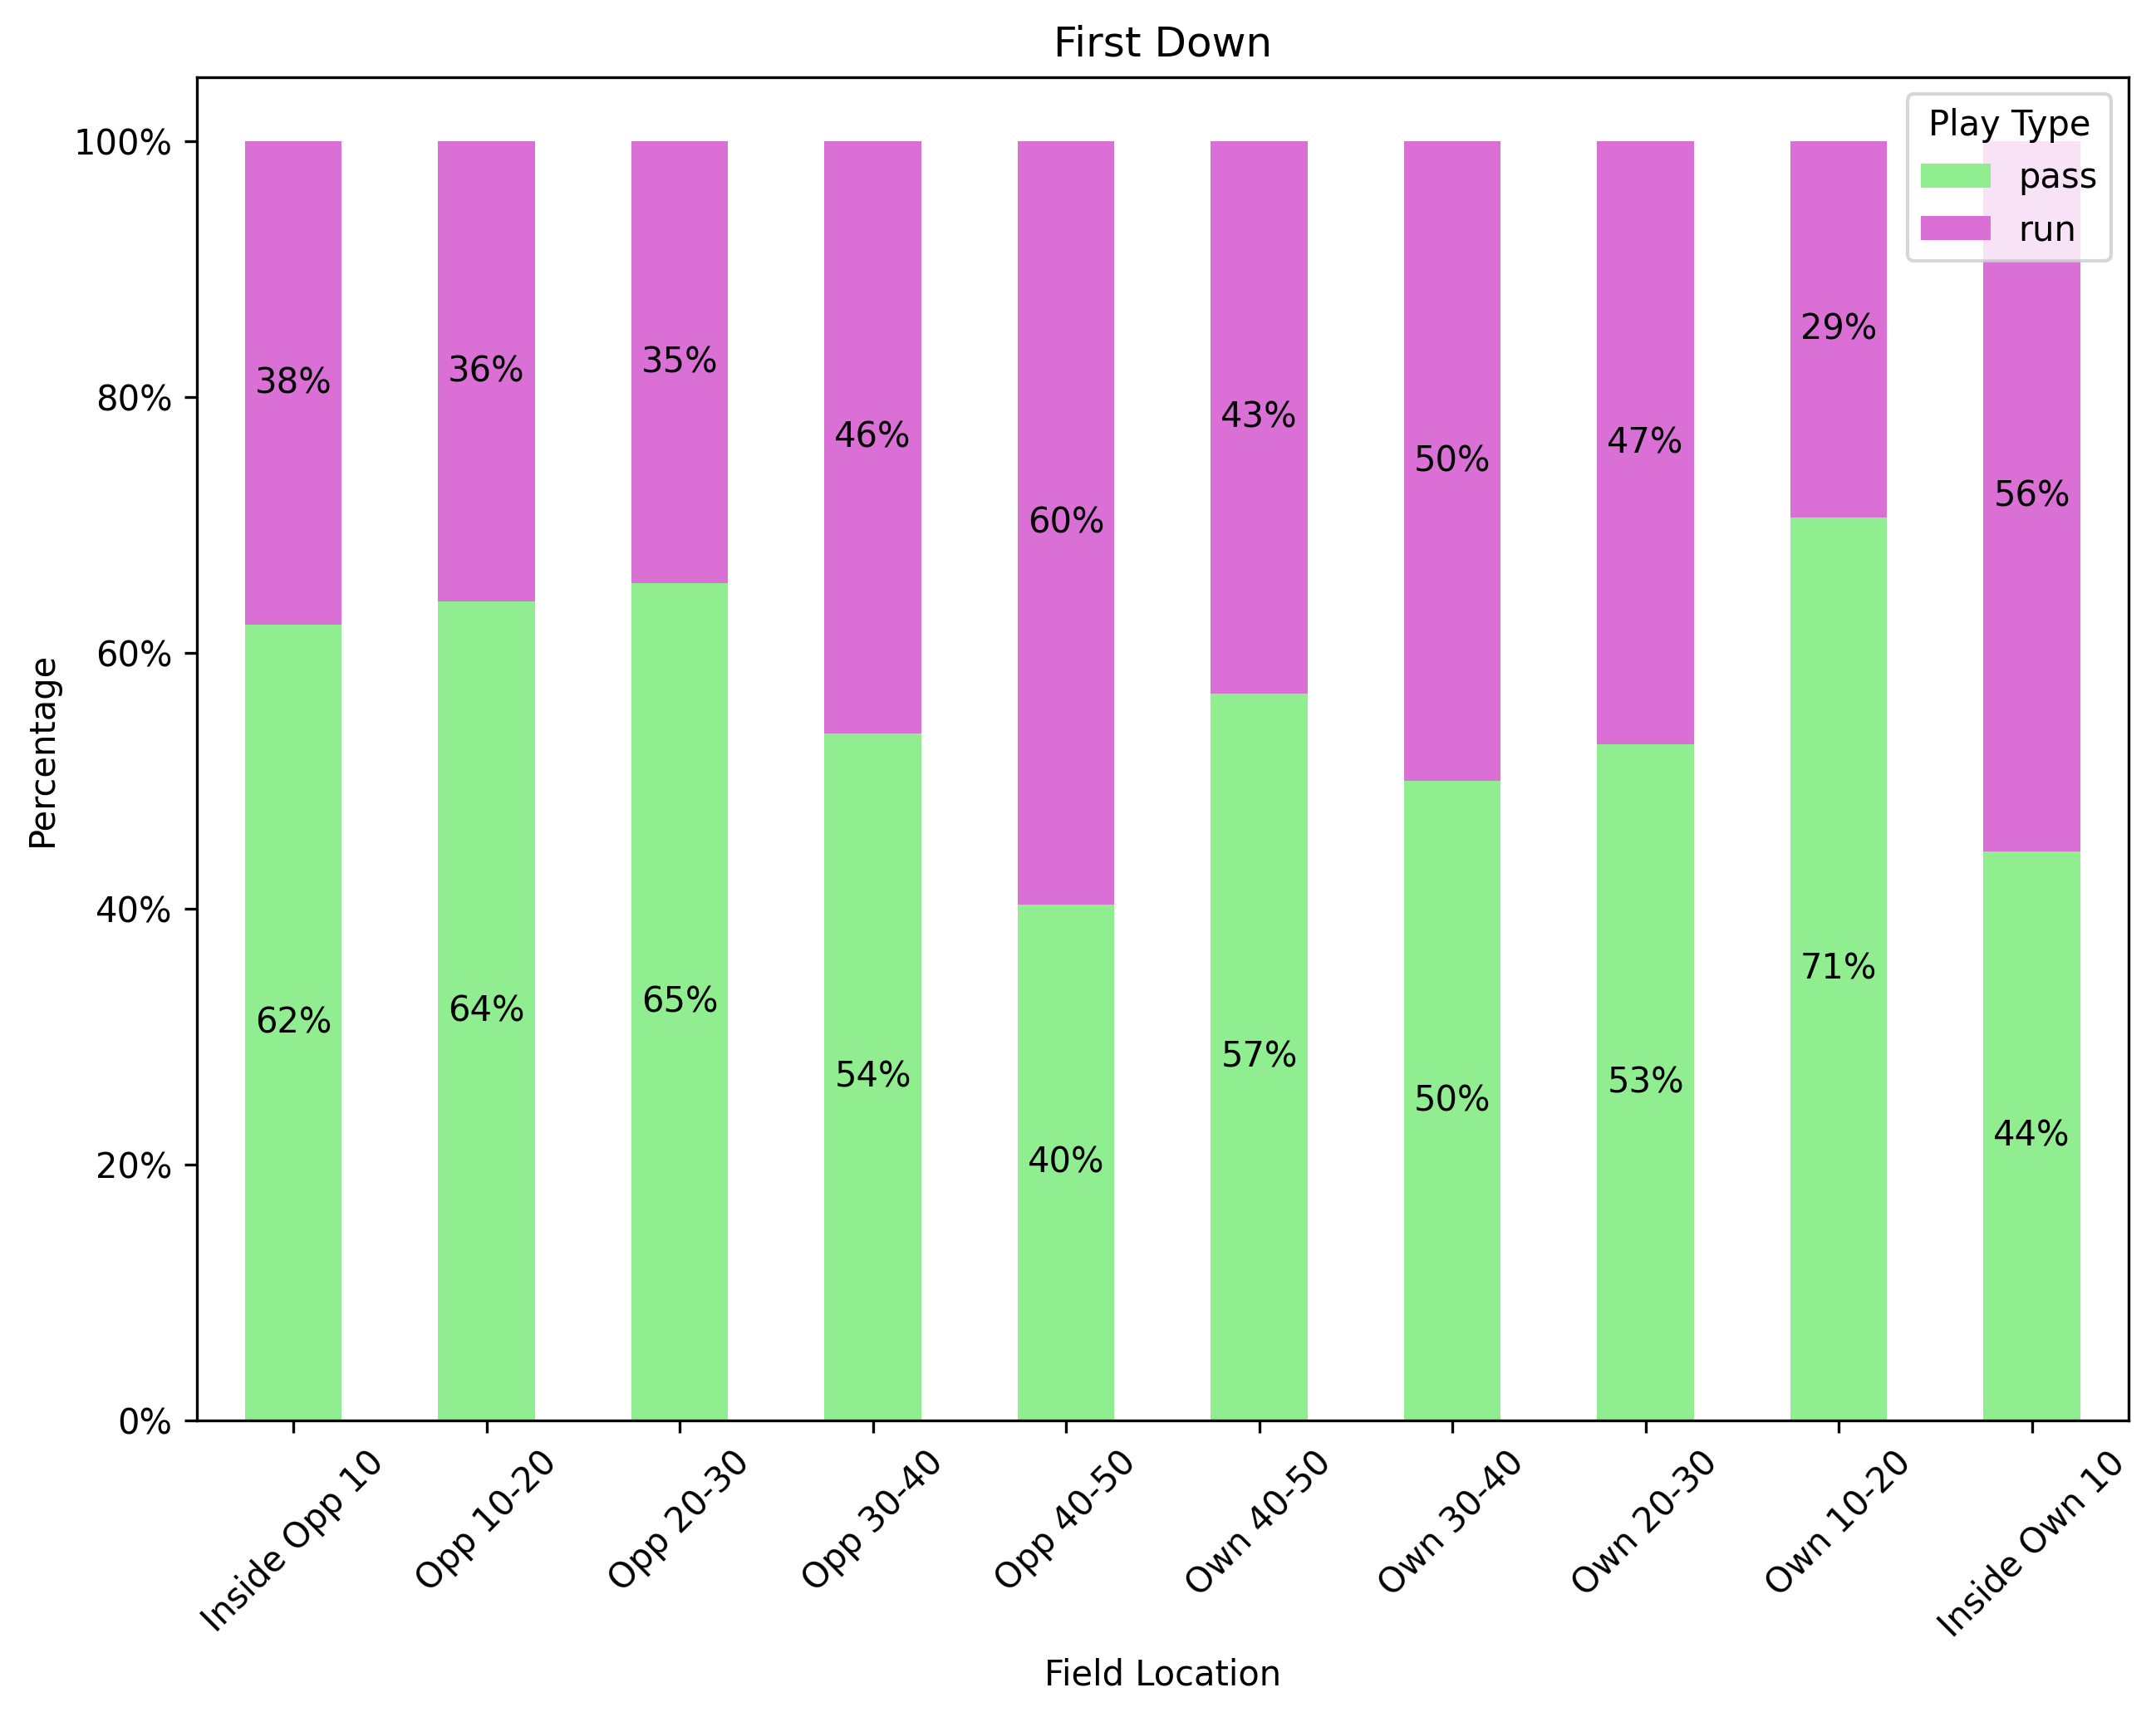
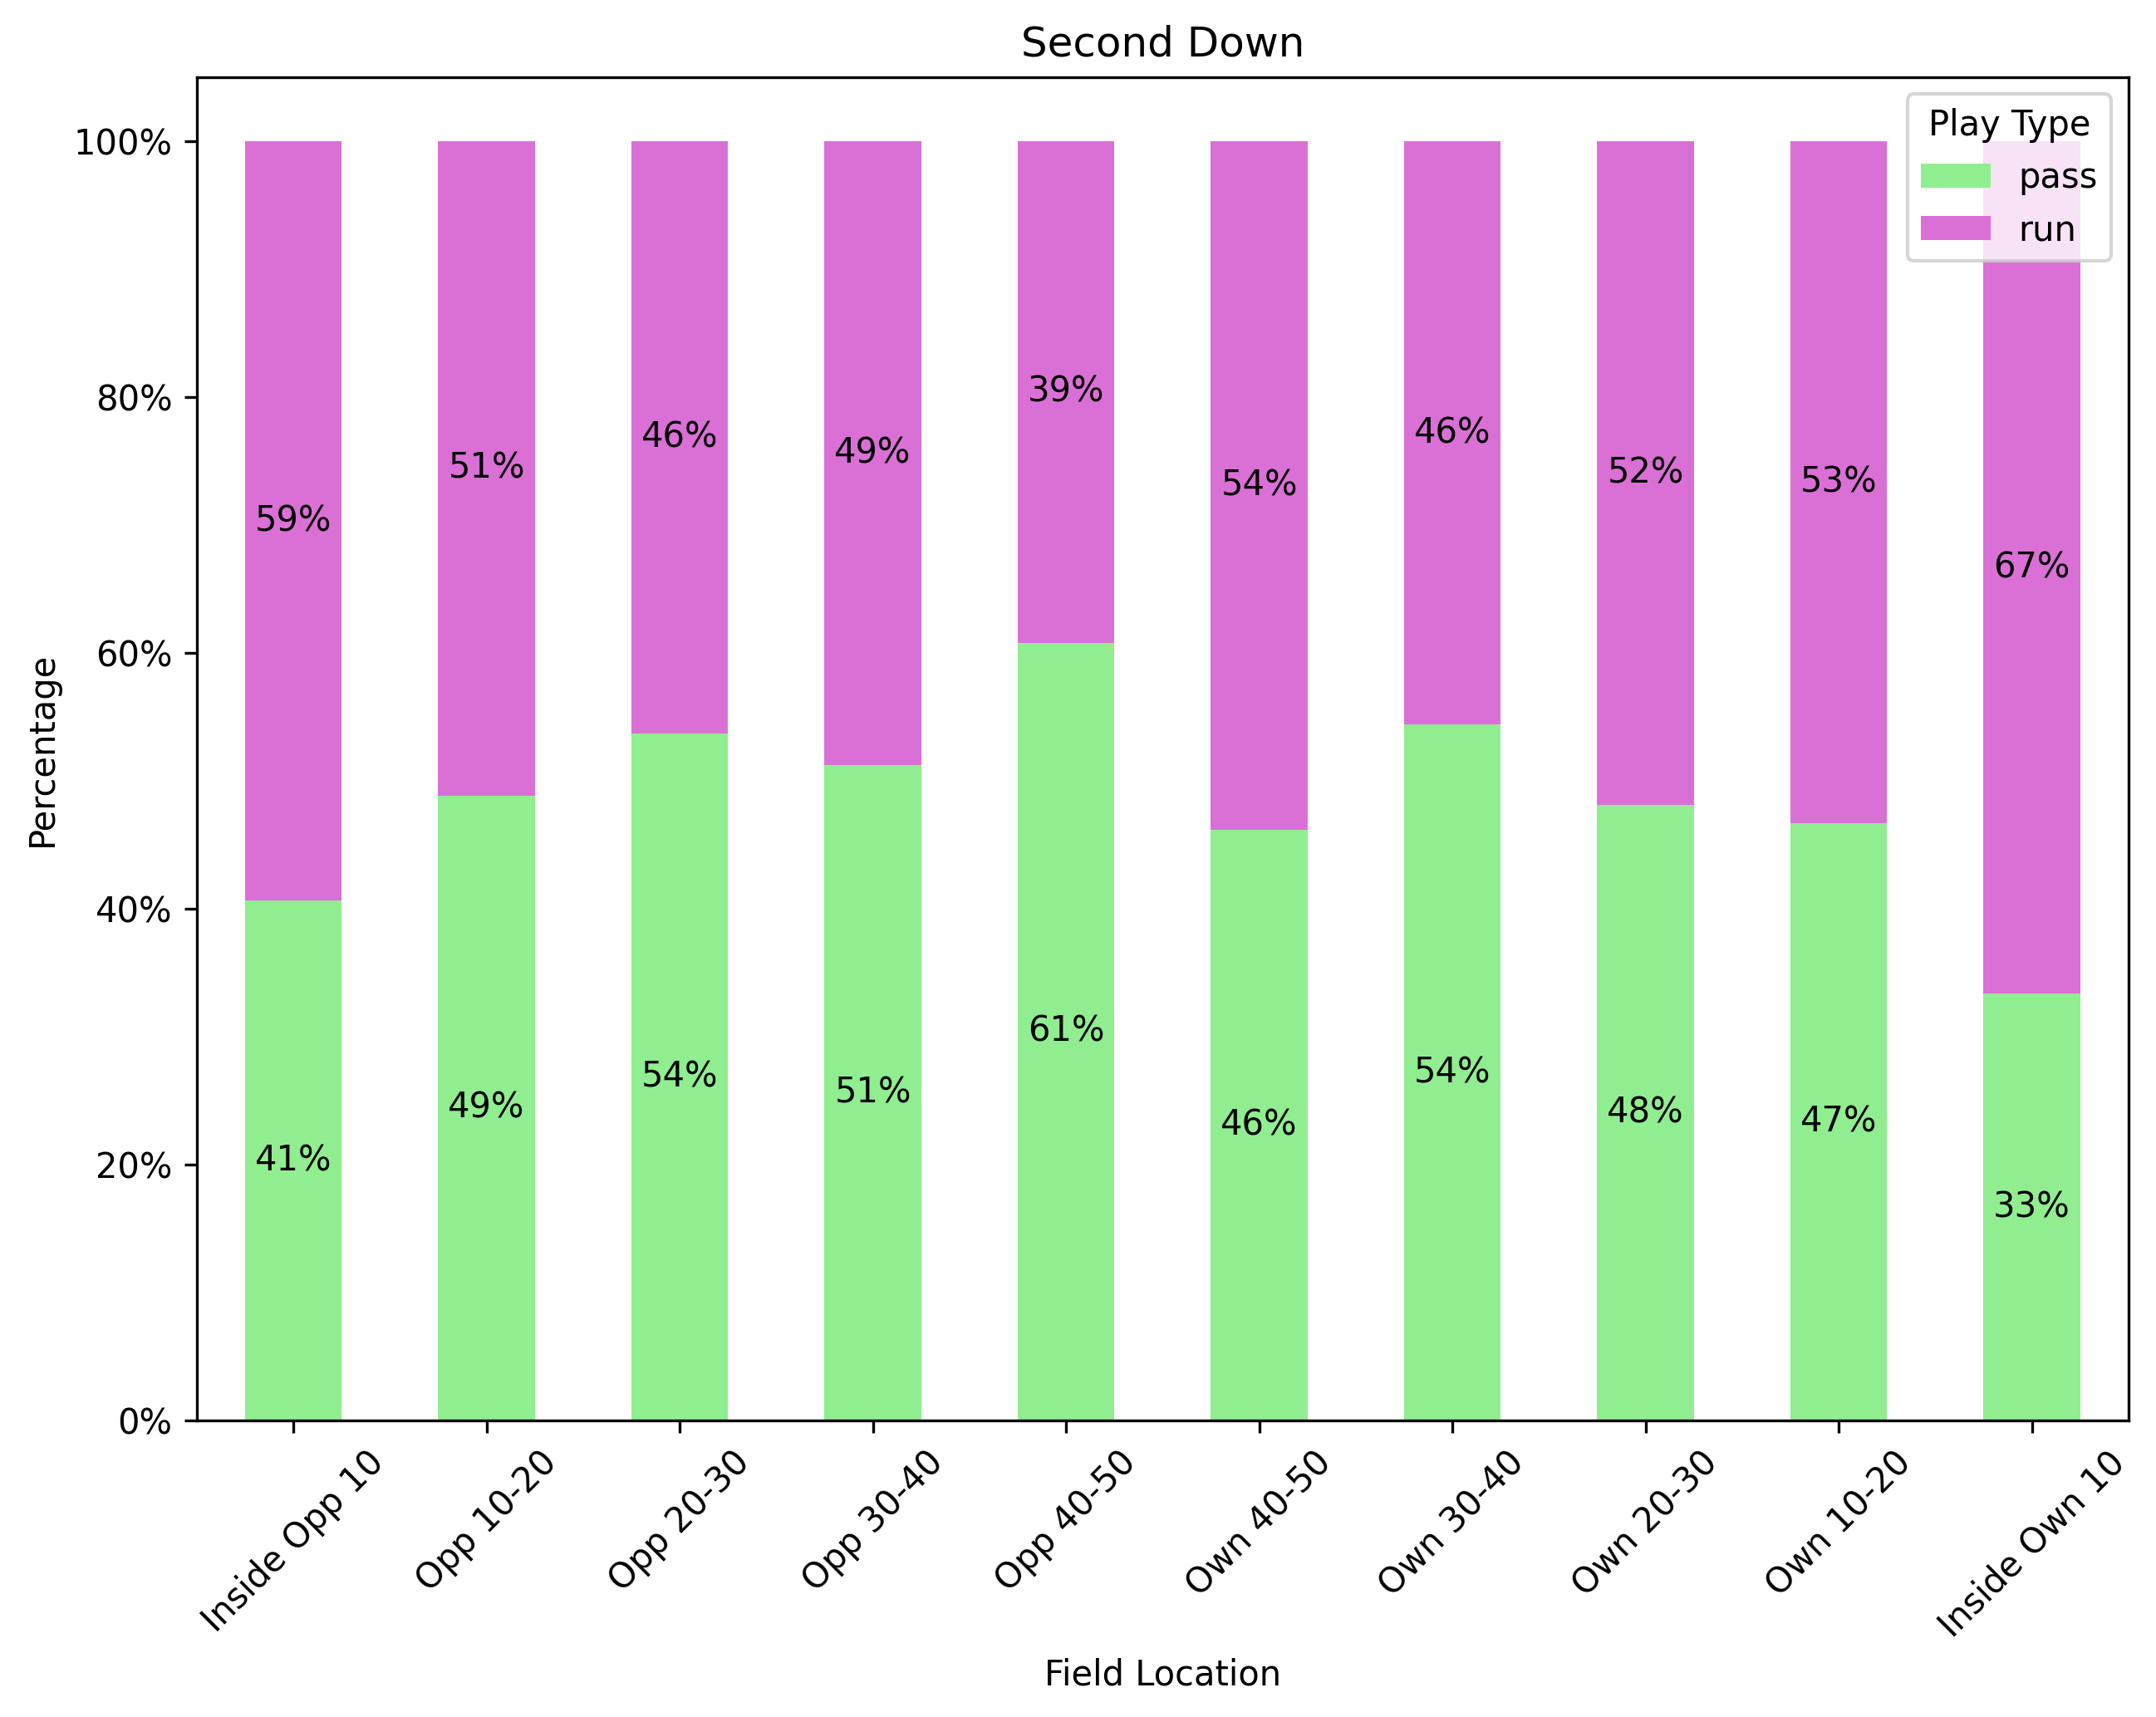
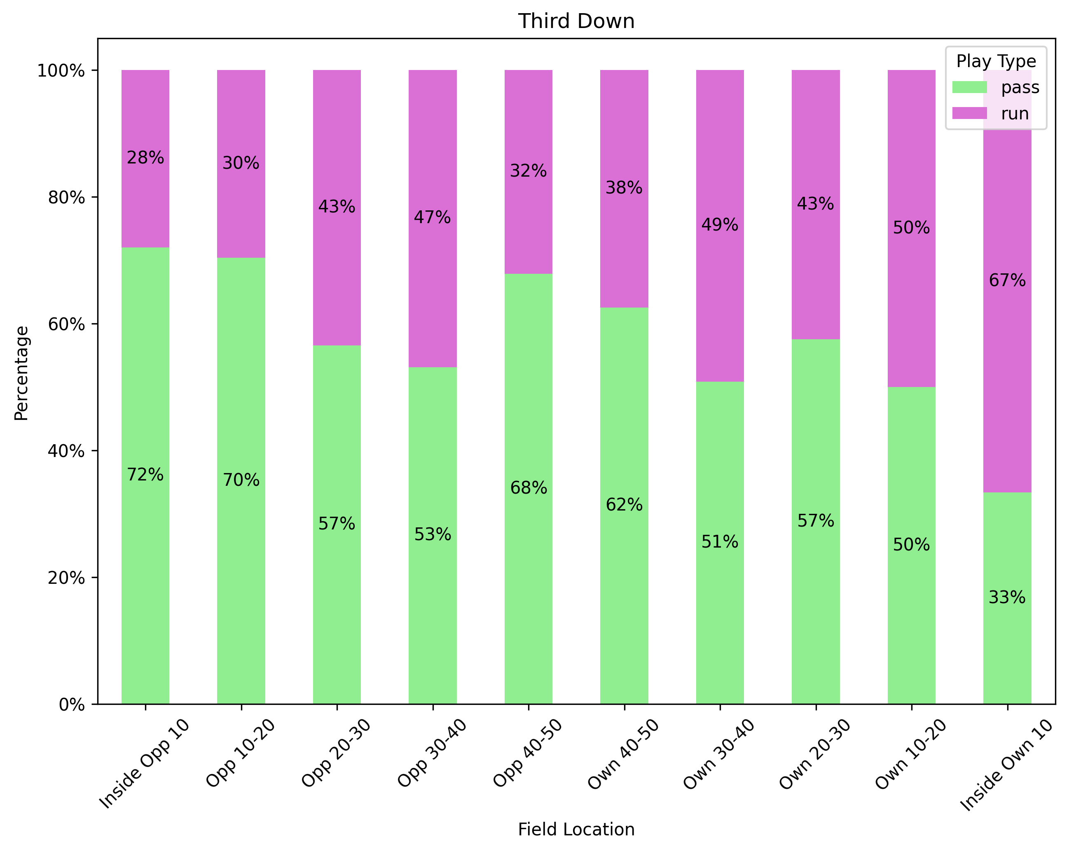
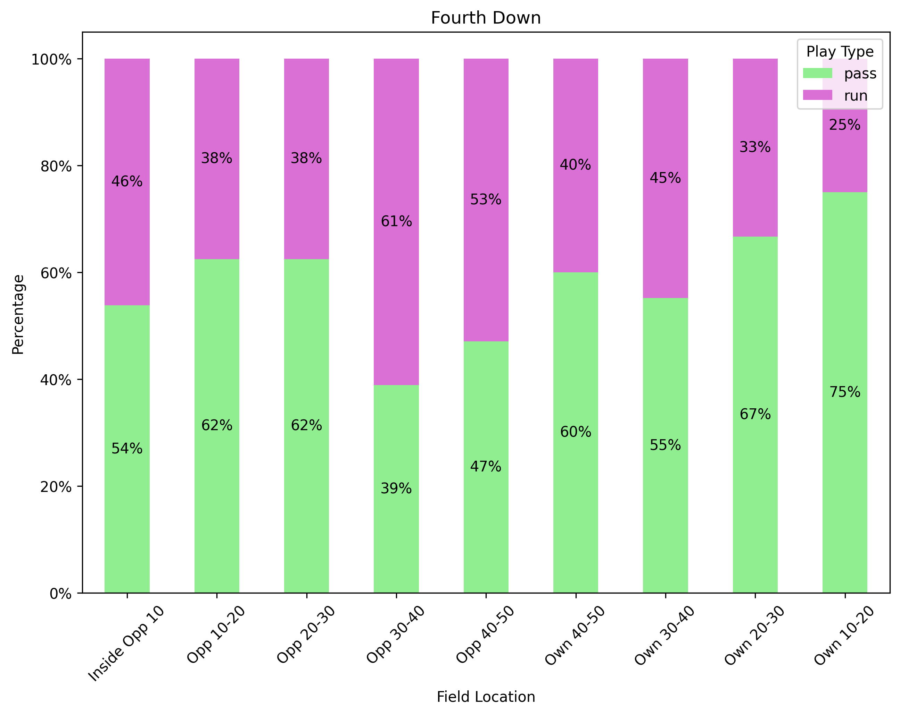

Slide 9
WHAT ARE the conversion rates for possessions downs? What tendencies did you identify?

Slide 10
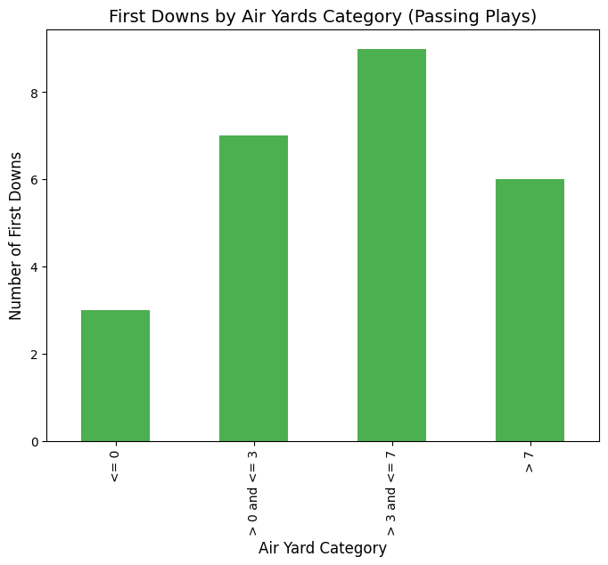
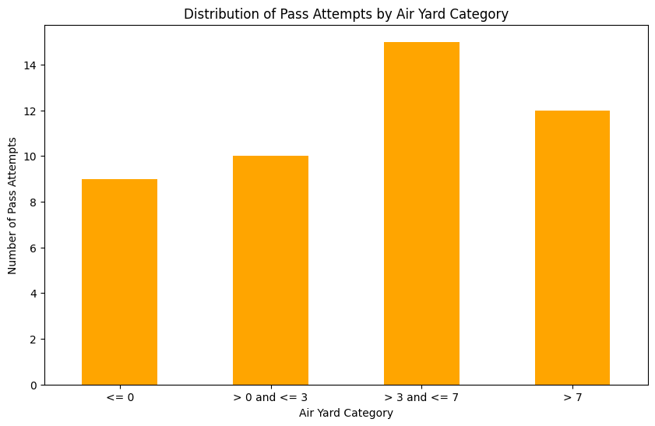
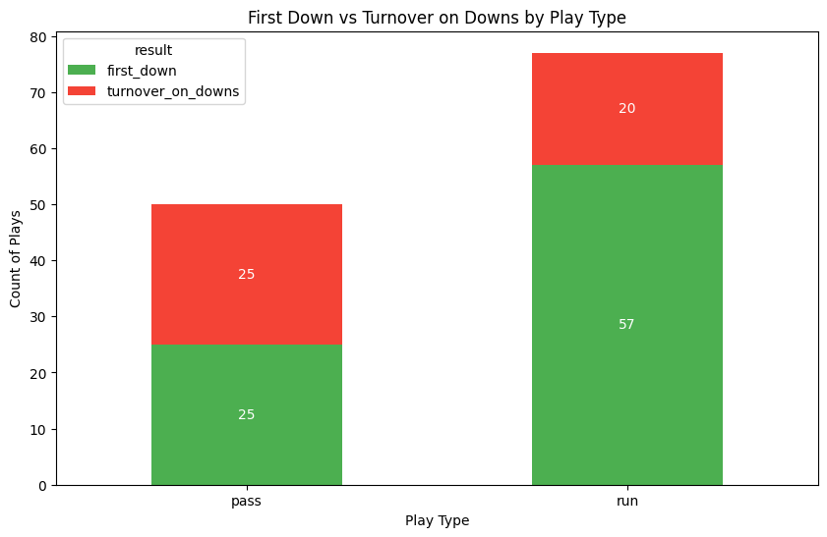
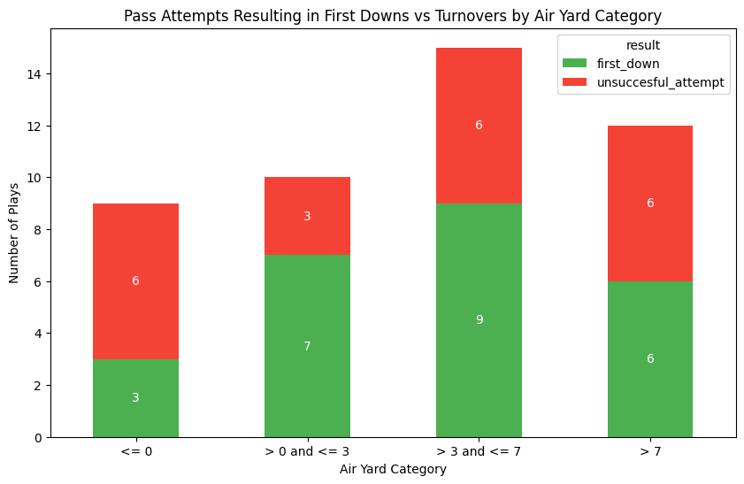

Slide 11
HOW DO DIFFERENT TEAM Statistics correlate with winning outcomes in week 1 games?

Slide 12
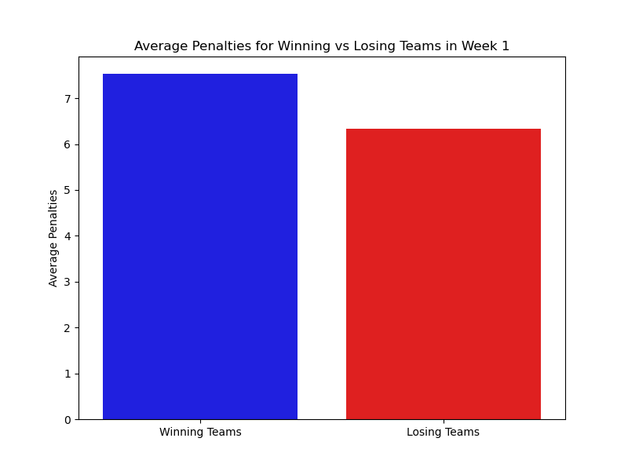
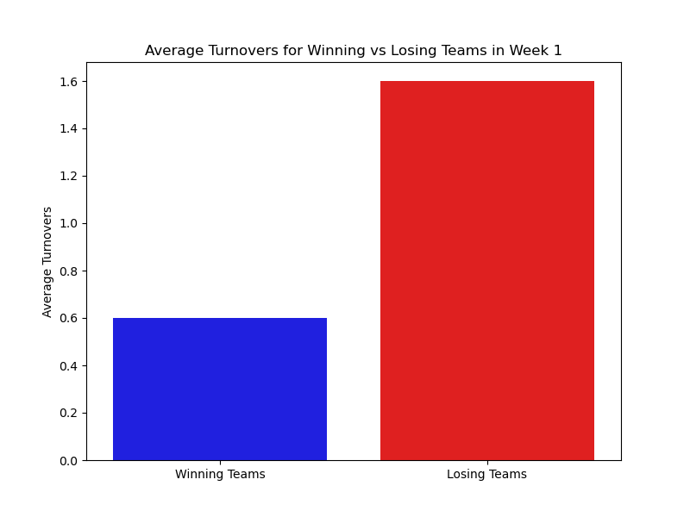

Slide 13
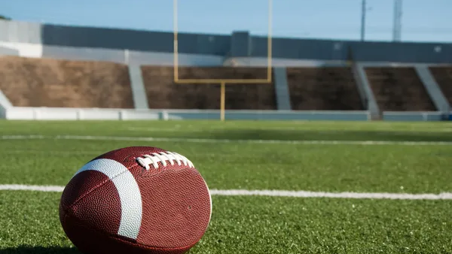
WEBSITE
https://rollernathan.github.io/NFL_2024_Week_1/

Slide 14
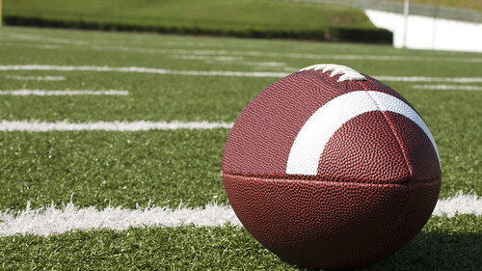
CONCLUSION
From the data analysis, several key factors emerge as the drivers of success in NFL games:
Play Type and Risk: While passing plays can lead to greater yardage and more first downs, they are also more prone to turnovers. Teams need to balance risk and reward depending on the game situation.
Yardage as a Predictor: Gaining more yards is typically correlated with winning games. However, the ability to translate those yards into points (by avoiding turnovers and penalties) is crucial for success.
Discipline in Play: Winning teams consistently committed fewer penalties, showing that disciplined play is essential to avoiding setbacks and securing victories.
Turnover Avoidance: Turnovers are a significant detractor from a team's chances of winning. Protecting the ball is one of the most important factors for winning games.
In summary, while yardage and play type play important roles in game outcomes, the ability to minimize penalties and turnovers often makes the difference between winning and losing in the NFL.

Slide 15
THANK YOU

Slide 20
Research Questions
- How do teams perform offensively and defensively in NFL Week 1 games?
-What are tendencies for teams in specific down and distance situations?
-How do different team statistics correlate with winning outcomes in Week 1 games?
-What are the conversion rates for possession downs? What tendencies did you identify?

Slide 21
HOW DO DIFFERENT TEAM Statistics correlate with winning outcomes in week 1 games?

Slide 22

HOW DO TEAMS PERFORM OFFENSIVELY IN NFL WEEK 1 GAMES?

Slide 23
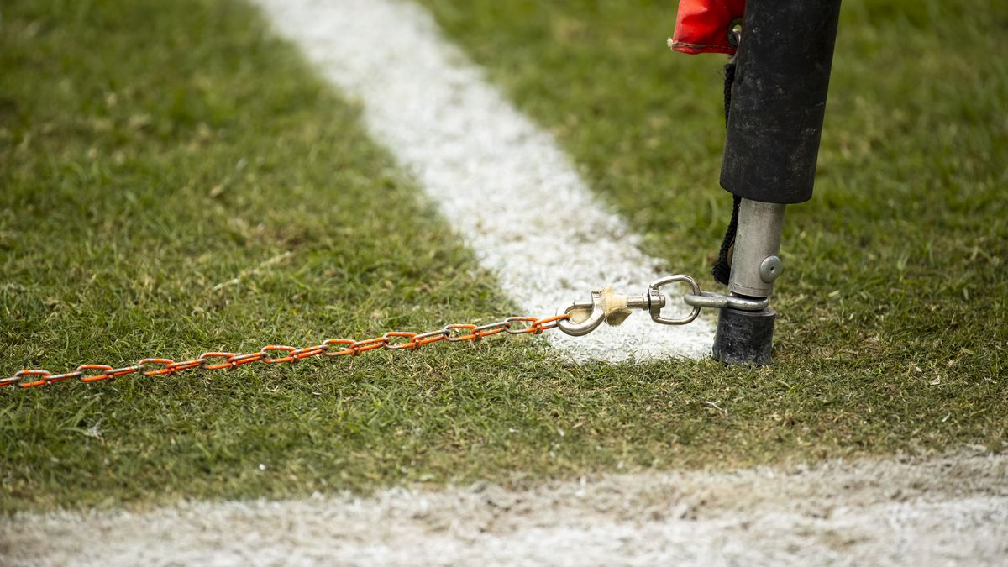
WHAT ARE the conversion rates for possessions downs? What tendencies did you identify?

Slide 26
WHAT ARE the conversion rates for possessions downs? What tendencies did you identify?

Slide 27
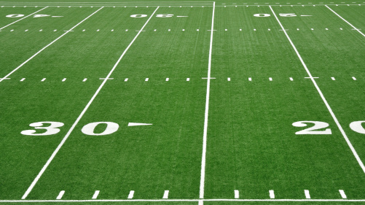
What are tendencies for teams in specific down and distance situations?

Slide 29
DATA SOURCE
2024 Week 1 Game Log
kgjlgj

